Slide 1
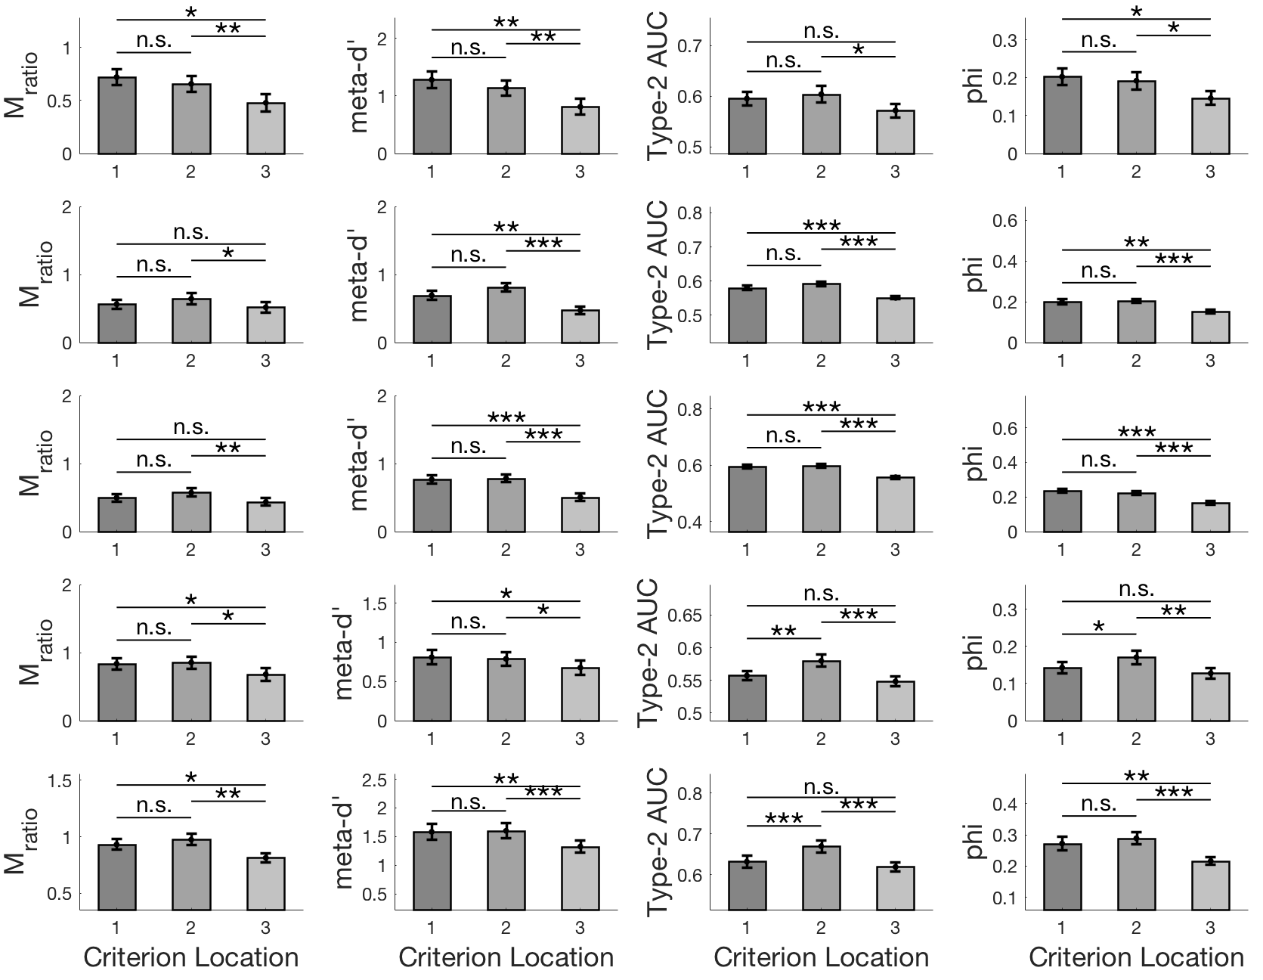
M_{ratio}
meta-d’
Type-2 AUC
phi
Experiment 1
Experiment 2a
Experiment 2b
Experiment 3a
Experiment 3b

